Slide 1

welcome to S&M Real Estates
Group 10

Slide 2
About us
Service: Helping Customers pick the perfect house
1 week old startup based in Brooklyn.
Only 2 employees –CEO AND CTO

Slide 3
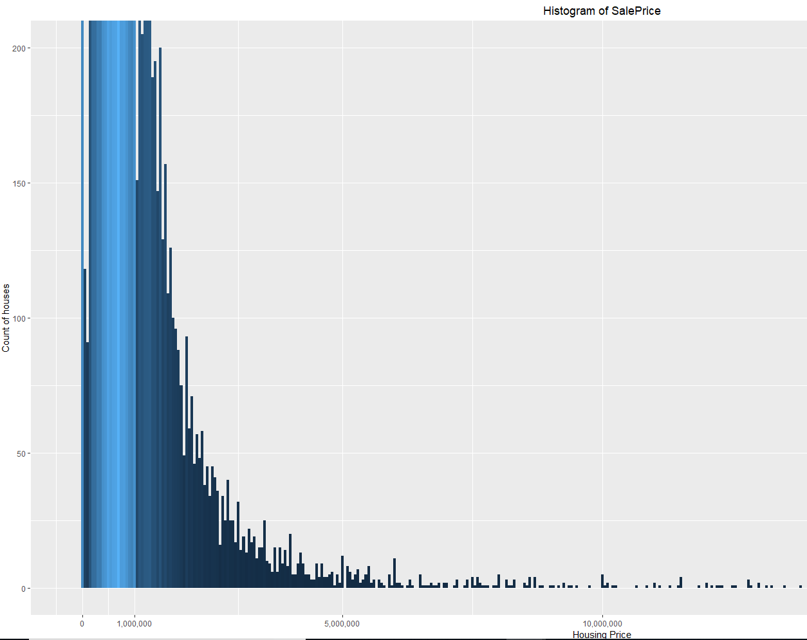
HOUSING PRICE - FIRST THINGS FIRST
The distribution of sales price
Positively skewed
Set the budget for 1,000,000$

Slide 4
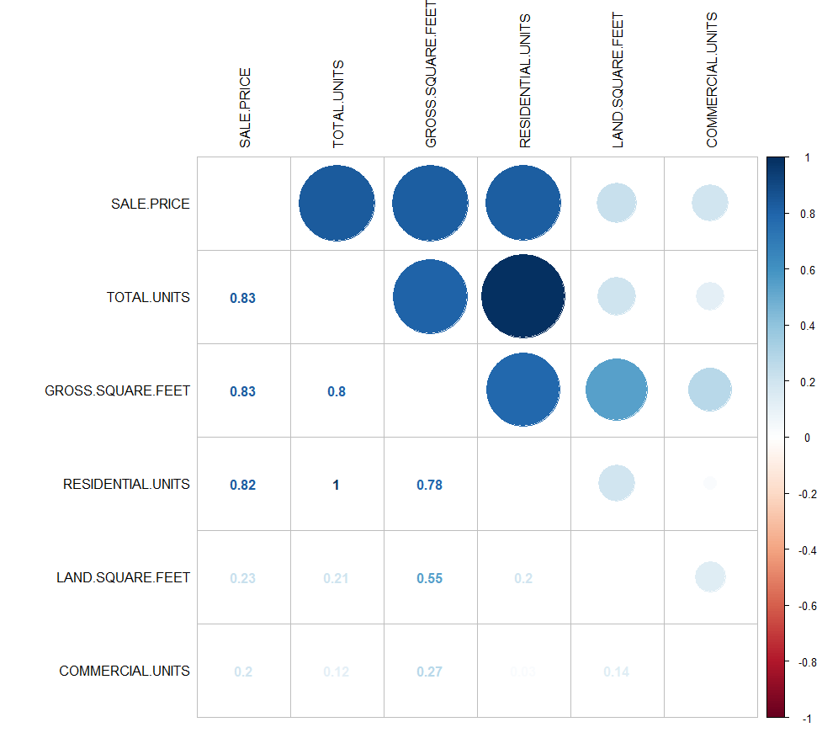
The important factors determining the house price
Total units
Gross square feet
Residential units
Categorical variables
Building class
Tax class
Neighborhood

Slide 5
1. Neighborhood
First thing first, we want to choose our neighborhood
Consideration: popularity, safety
Any advice?

Slide 6
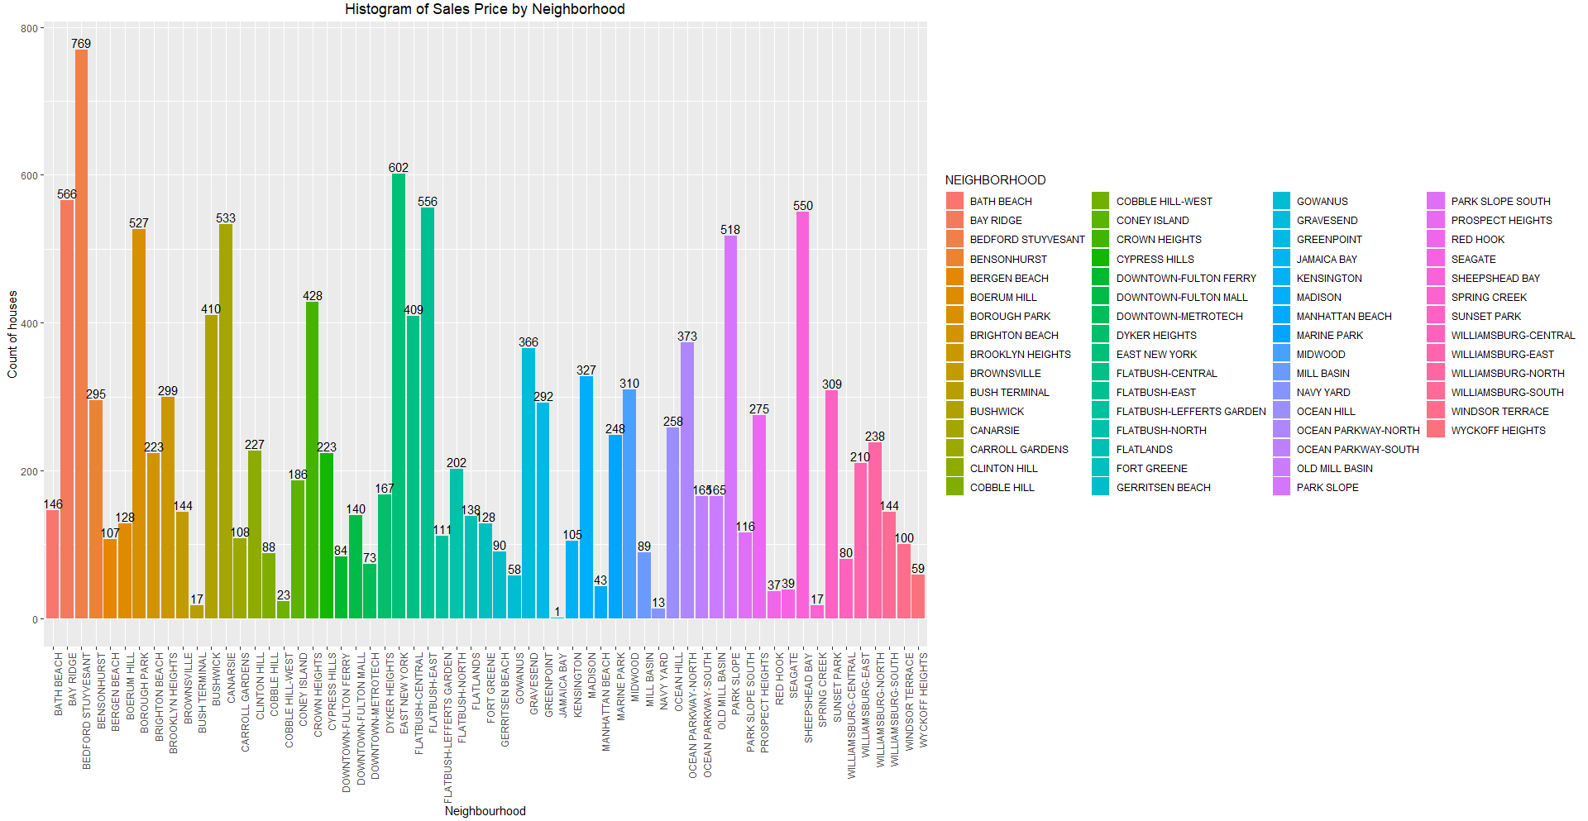
Which neighborhoods are most popular?

Slide 7
Most popular neighborhoods
BEDFORD STUYVESANT
EAST NEWYORK
BAY RIDGE
FLATBUSH CENTRAL
SHEEPSHEAD BAY

Slide 8
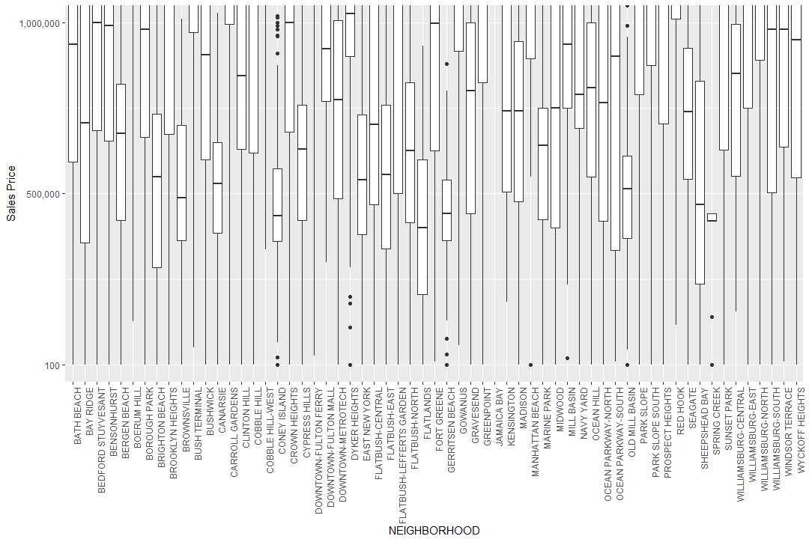
The sales price of different neighborhoods
HIGEST MEDIAN PRICE
LOWEST MEDIAN PRICE

Slide 9
2. TAX CLASS
Which tax class you belong to?
Class 1: Most residential property of up to three units
Class 2: Cooperatives and condominiums.
Class 3: Gas, telephone or electric company.
Class 4: Offices, factories, warehouses, garage buildings, etc.

Slide 10
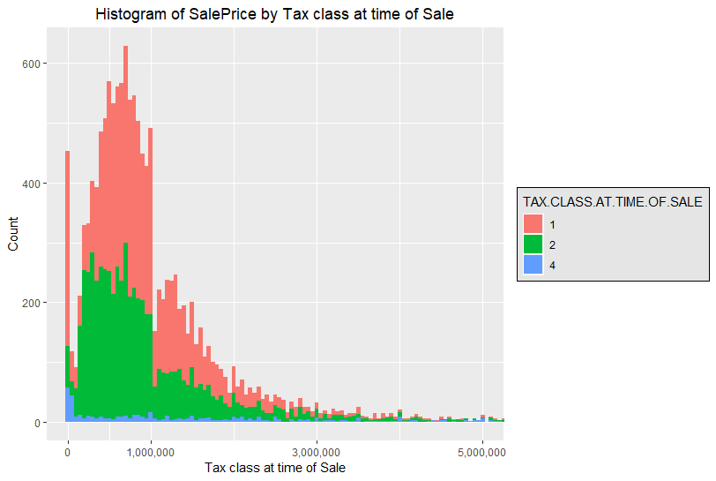
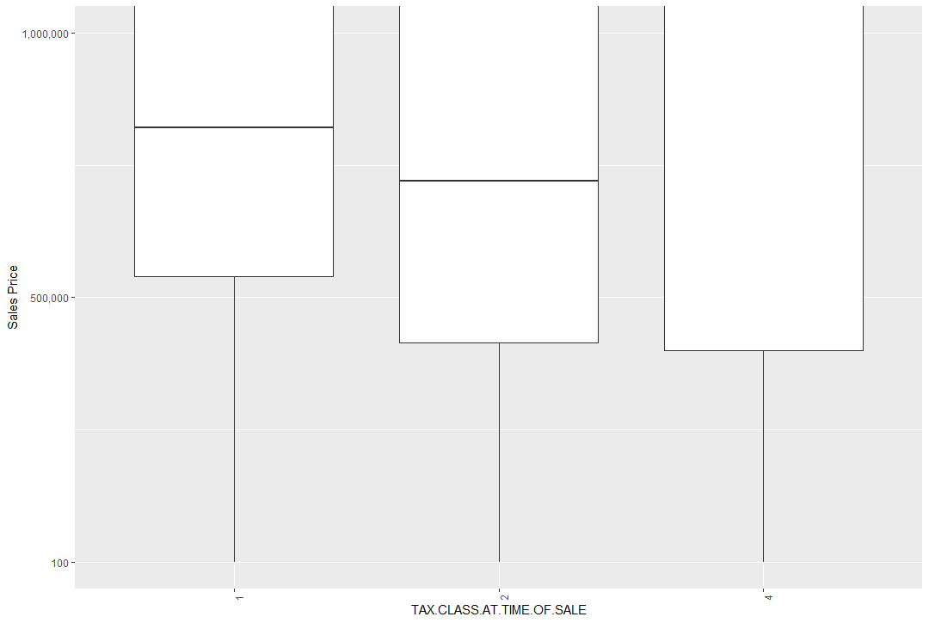
2. TAX CLASS
Which tax class we belong to?

Slide 11
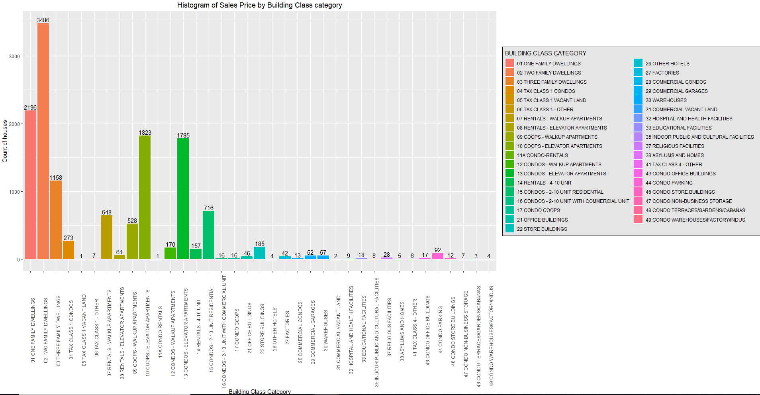
3. BUILDING CLASS
Prefer one family rooms or two family rooms

Slide 12
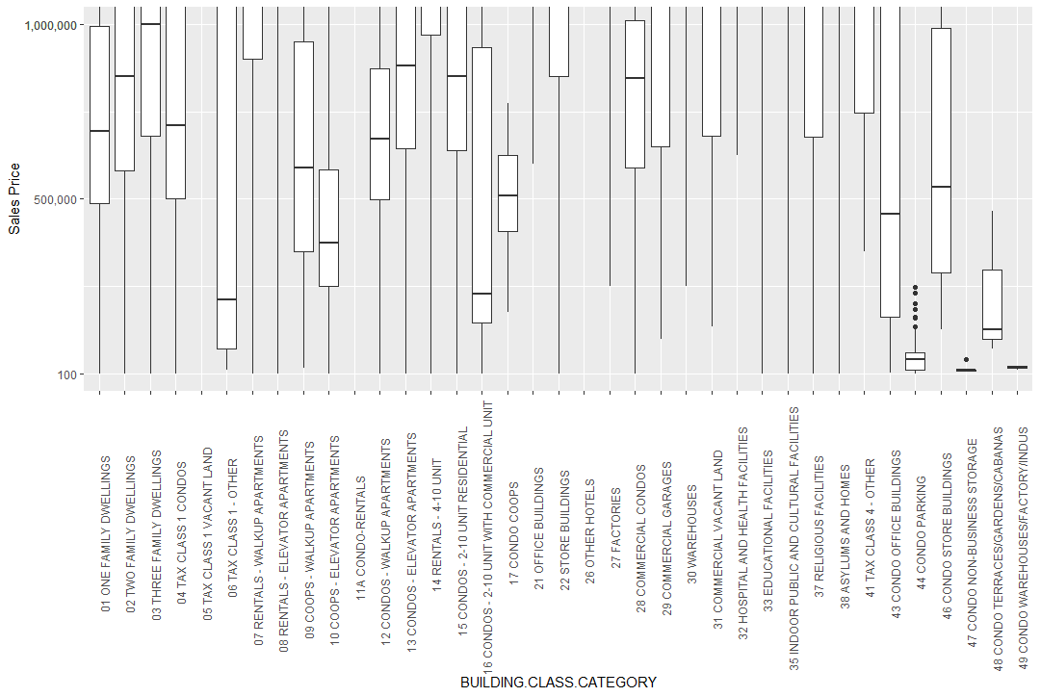
EVEN THREE FAMILY DWELLINGS FALLS WITHIN YOUR BUDGET

Slide 13
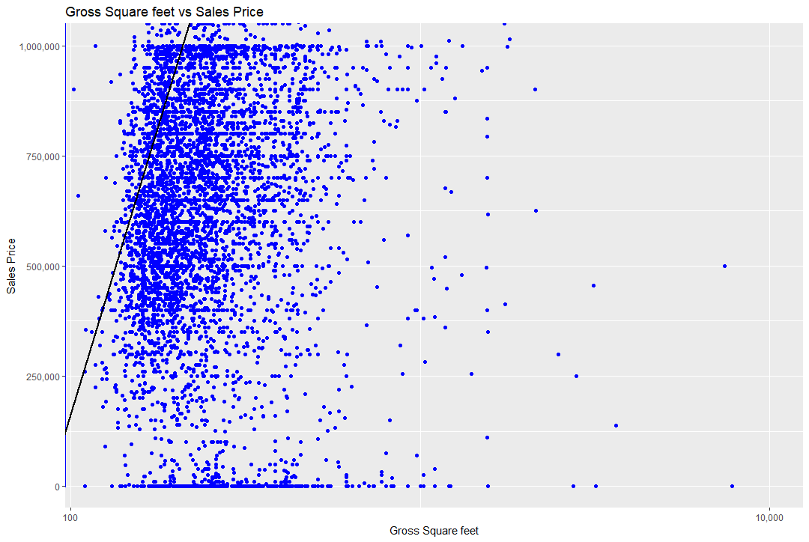
4.GROSS SQUARE FEET
What is the size of the house which we can expect within the budget?
Within budget, you can expect the gross square feet ranging from
500 -5000 sq.ft.

Slide 14
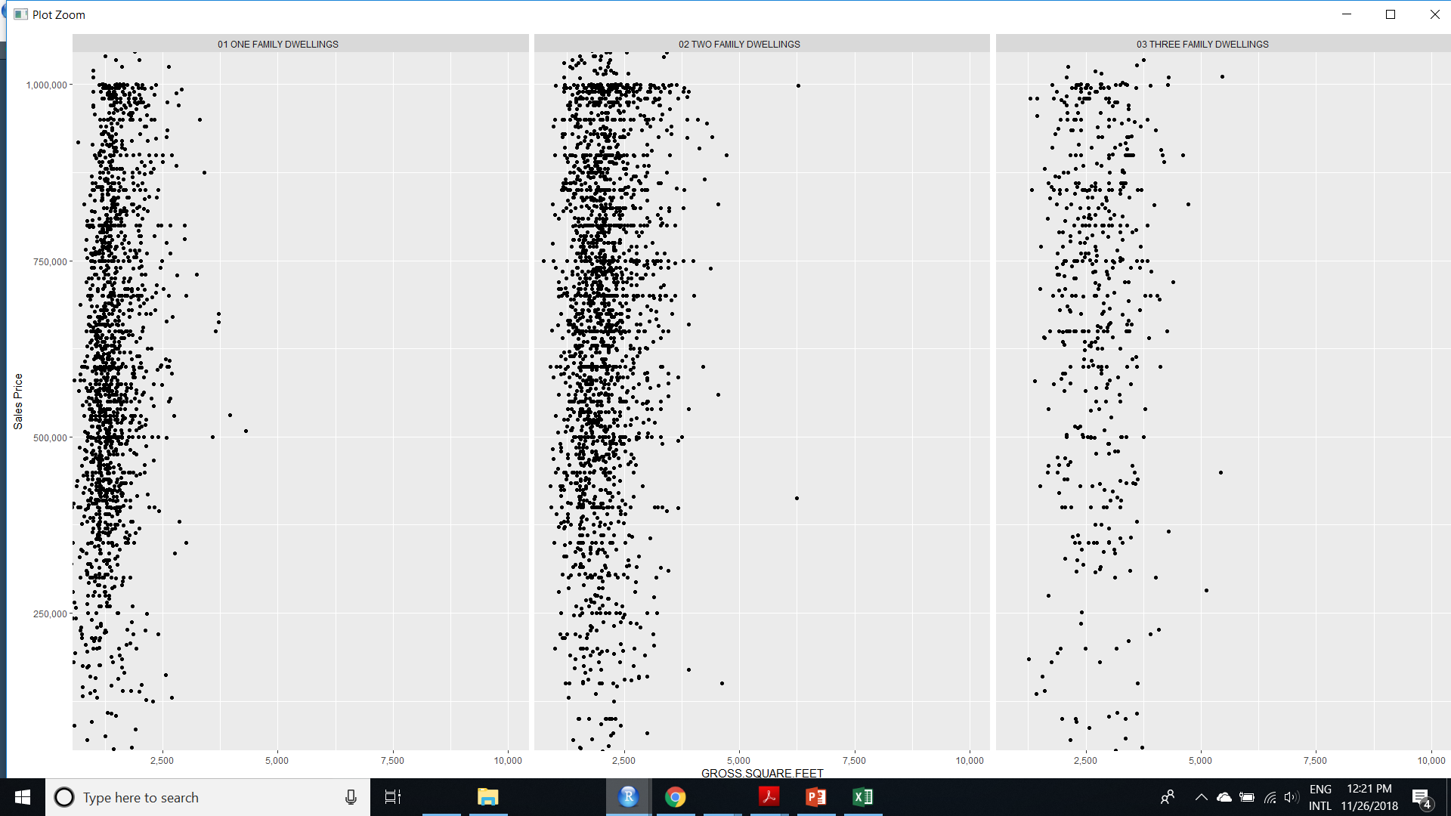

Slide 15
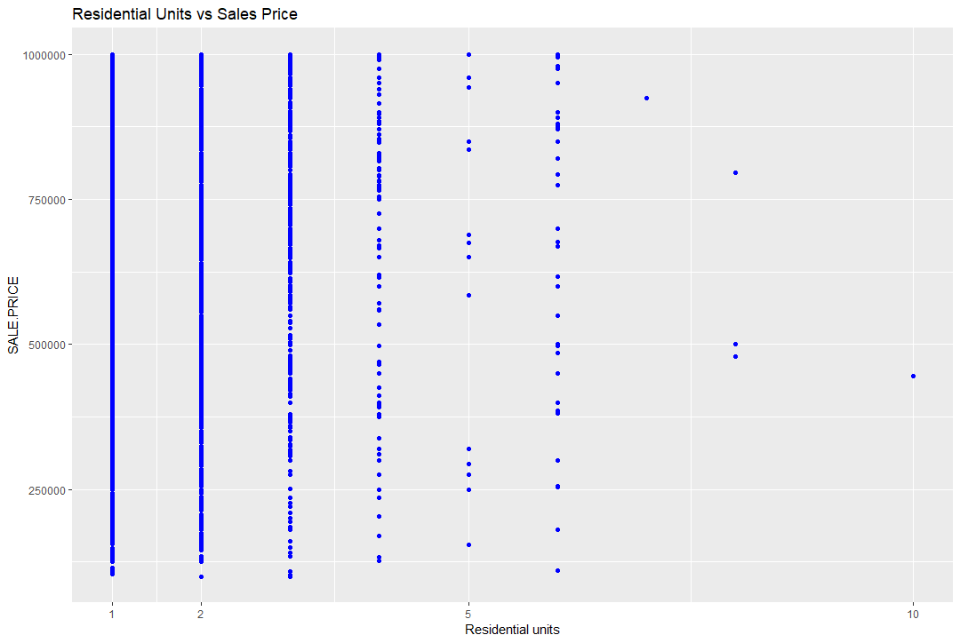
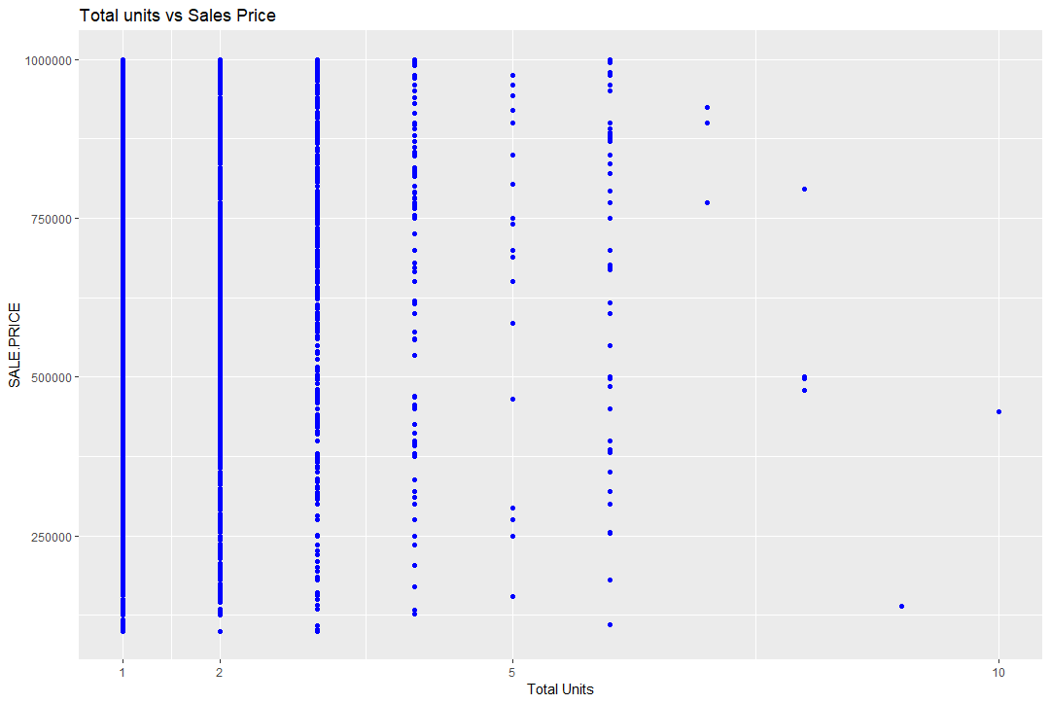
5. TOTAL AND RESIDENTIAL UNITS
Relationship between sale price and total units

Slide 16
One month later…

Slide 17

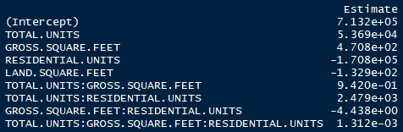


MODEL BUILDING
MODEL 1 - LINEAR WITHOUT INTERACTION
MODEL 2 - LINEAR WITH INTERACTION
MODEL 3- RIDGE
MODEL 4 - LASSO

Slide 18
Model comparison
MODEL 1 | MODEL 2 | MODEL 3 | MODEL 4
73.26% | 74.67% | 48.62% | 52.98%
1.218338e+14 | 9.272203e+12 | 1.1289204469e+10 | 9.9786e+13
R²
MSE
BEST R²
LOWEST MSE

Slide 19

The dream house for you

Slide 20
The end!!!
THANKS FOR YOUR ATTENTION

